Slide 1

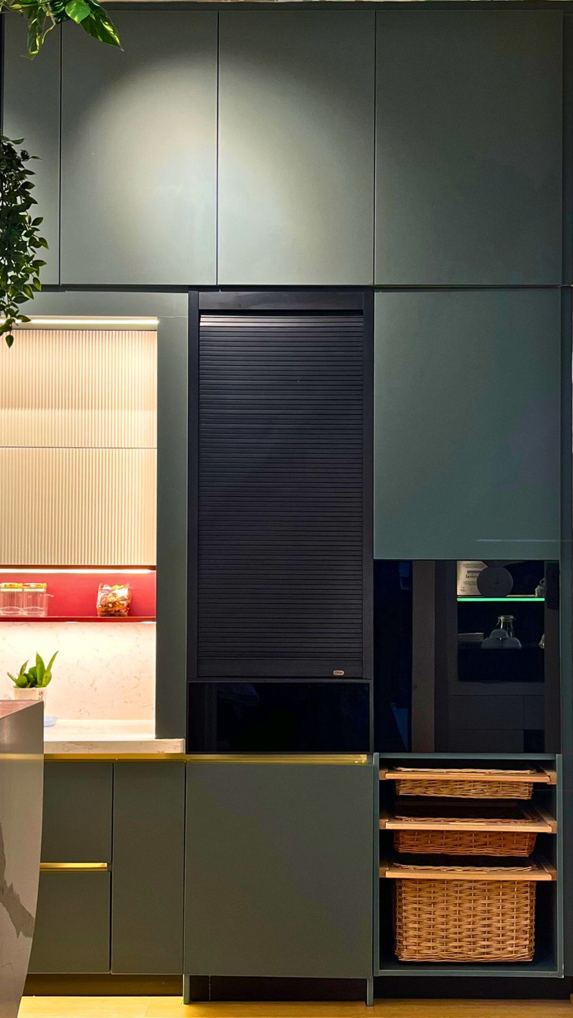
Client name & DT code
Designer name

Slide 2




Slide 3

Plan :
MATERIAL DETAILING – ROOM NAME (Option 1)
Colour concept : Eg - minimlistic
Colour pallet :
Laminate suggestion : (Code with Photo)
RENDERS

Slide 4
RENDERS

Slide 5
RENDERS

Slide 6
Plan :
MATERIAL DETAILING – ROOM NAME (Option 2)
Colour concept : Eg - minimlistic
Colour pallet :
Laminate suggestion : (Code with Photo)
RENDERS

Slide 7
RENDERS

Slide 8
RENDERS

Slide 9

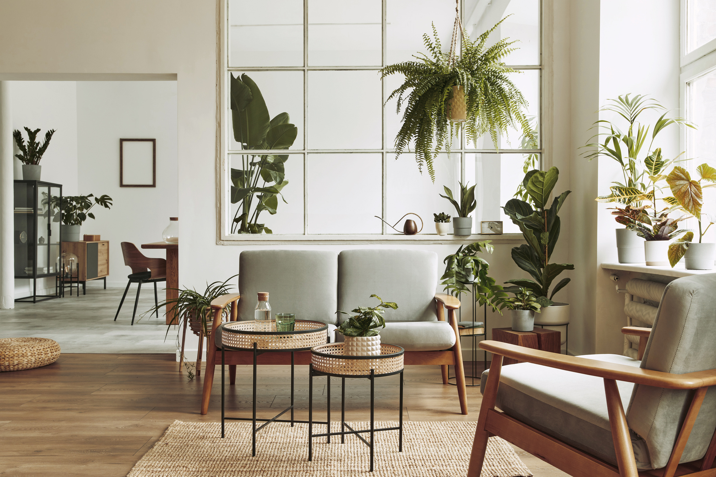

THANK
YOU

